Slide 1


Investor Deck
April 2018

Slide 2
EXECUTIVE SUMMARY
0.
Digital solutions based on Wifi and Beacons technology
IVIZONE is a Paris-based digital marketing and technology company that detects, identifies and engages with smartphone users through Wi-Fi and Beacon Technology.
Today's mobile-first customer provides the opportunity to recognize every visitor who walks in the door, understand what drove that visit and retarget to influence a purchase. IVIZONE analyze customer behavior, and collect demographic and customer profiles via a cloud-based captive portal. This provides marketers a unique set of tools to build a full view of the customer journey.
In short, IVIZONE generates the missing link between the Online and Offline world and provide marketing opportunities with a unified and multichannel customer profile.
As of today, the company has a turnover of ~€200 k, divided between the captive portal (65%), location analytics (35%)
The company as a strong traction (+30 clients have booked the solution) and is working on the development of an eco-system of high-performance partners with IT vendors (Aruba, Cisco, Extreme Networks) and IT integrators (Axians, Aciernet, Orange...)
Strengthening the relationship between manufacturers (Aruba Engage Partner, Meraki Challenge, ExtremeConnect)
Develop a Partner program (Support, Discount, Challenge)
Online Prospecting
The company is seeking ~€500 k€ in order to:
Finalize the product development (cloud platform centralizing the management and collection of data from WiFi)
Invest in Marketing Campaign & Brand Image

Slide 3


PAINT POINT
0.
Managing the digital transformation of public venues (stores, agencies, franchises, cities…)
Nowadays, there is a disconnect between IT and Marketing on the value of collaboration and the roles within their relationship. But there is an increasing pressure to transform IT into a Business.
It's time to break silos and unite IT with Marketing professionals to influence Web and Mobile strategies, Digital Growth and Marketing Automation – achieving an overarching goal of delivering improved customer experience through data strategy.
X
Marketing
IT

Slide 4


SOLUTION
0.
Providing strong marketing tools to public venues
By providing solutions based on Wi-Fi and Beacon infrastructures, Ivizone represents the missing link between Technology and Marketing .
Ivizone solutions bring the relevant digital tools to detect, identify and engage with visitors in-store.
LOCATION ANALYTICS
CAPTIVE PORTAL

Slide 5
CAPTIVE PORTAL OPPORTUNITY
0.
After a big growth in 2015, the Wi-Fi market is still increasing and especially the Wi-Fi public spaces market. In fact, between 2013 and 2017, $8.5 bn will be invested in Wi-Fi equipment for public spaces only. The value of the public Wi-Fi market in 2017 is estimated to be of $3 bn.
While North-America is now the biggest market for Wi-Fi equipment, in 2017 the EMEA region and the Asia-Pacific region could become the biggest markets.
x3
Investment in the Wi-Fi equipment will be multiplied by 3 in 2017
« We forecast more than 100M access points will offer Guest WiFi services by 2020, producing more than $25 bn in annual software licensing revenue.” Adlane Fellah, CEO of market research firm Maravedis
Source: Tanaza.com;

Slide 6
REFERENCES
0.

Slide 7
1.
PRODUCTS & ORGANIZATION

Slide 8
IVIZONE SOLUTIONS
2.1
The power of digital tools applied to the physical world
LOCATION ANALYTICS
CAPTIVE PORTAL

Slide 9




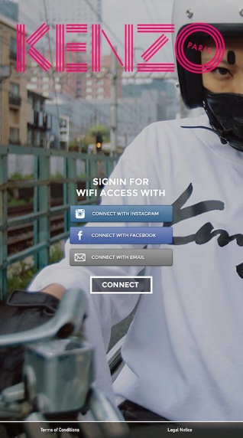





CAPTIVE PORTAL
2.2
Transform the captive portal into a powerful marketing tool
Marketing tools :
Qualified data collection (CRM integration)
visitor contact data
demographic data (social networking login)
Communicate directly on the visitors smartphones
customized campaign
Pop-up photos& videos…
Create engagement
Coupons, offers, newsletter, promotions…
Push notifications
ROI Proposition
Retail group: ETAM, Sephora, Lacoste, Krys Group…
Administration: Mairie de Paris, …
Large group: La Poste, Orange, Transdev…
Users
Setup fee (integrators)
Monthly Fee (3 formulas Lite, Normal, Advanced)
Business Model
Under finalization (see product roadmap)
30 clients have already booked the solution
Track Record

Slide 10










TECHNICAL ARCHITECTURE OF CAPTIVE PORTAL
2.3
Plug&Play 100% cloud based portal
Wifi User
Splash Page Server
Wifi Authentification
Wifi Access Point
Internet Traffic
Wifi Controller
Internet
Syslog Server

Slide 11
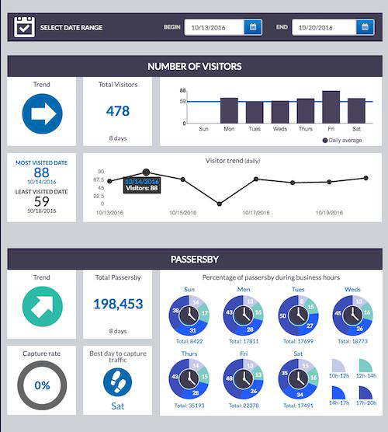
LOCATION ANALYTICS
2.4
Track Wifi, Bluetooth and Camera signals and analyze the visitors behavior on-site
Behavior analysis technology via smartphone signal :
Web-based dashboard to easily access behavior statistics
Customer paths
Traffic for window-front passerby
Number of visitors
Visit duration
Rebound rate
ROI Proposition
Retail group: Cartier, Promod, Isabel Marant, RougeGorge…
Service group: La Poste, ICADE…
Users
Setup fee (integrators)
Monthly Fee
Business Model
Under finalization (see product roadmap)
5 clients have already booked the solution
Track Record

Slide 12
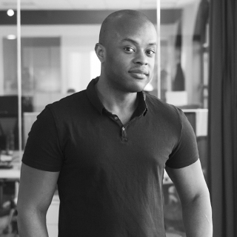


THE MANAGEMENT
2.5
A product driven team
Sydney Burks
Noël-Edouard Chenu
Eric Lebigot
CTO
Head of Sales
Lead Data Scientist
MIT, 2003
Mines de Paris, 2003
PhD en Optique et Information Quantique, Université Pierre et Marie Curie, 2010
NEOMA, 2009
Singapore Management University, 2007
Former Regional Sales Manager @ CISCO
Normale Sup, 2001
PhD in Quantum Physics
Former Researcher and AXA Chief Data Scientist

Slide 13
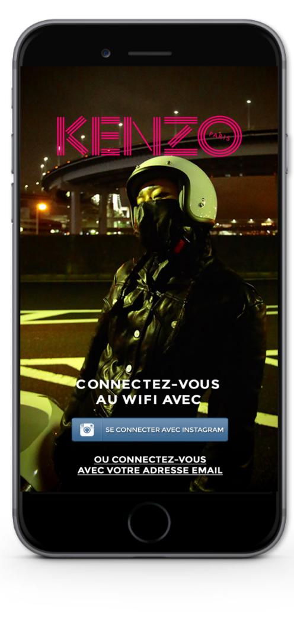
USE CASES
2.6
Captive Portal 1/2
Traffic Generation
Social Media
Responsive Captive Portal

Slide 14
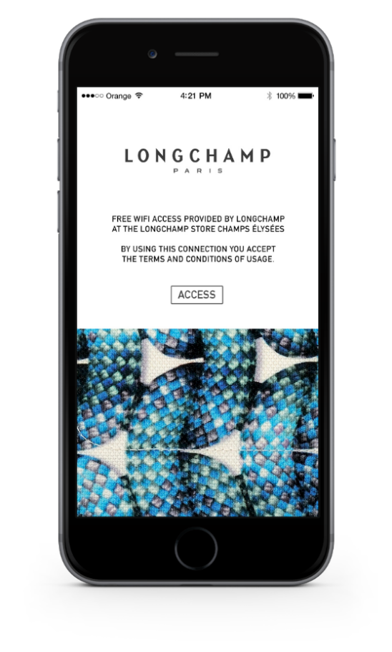
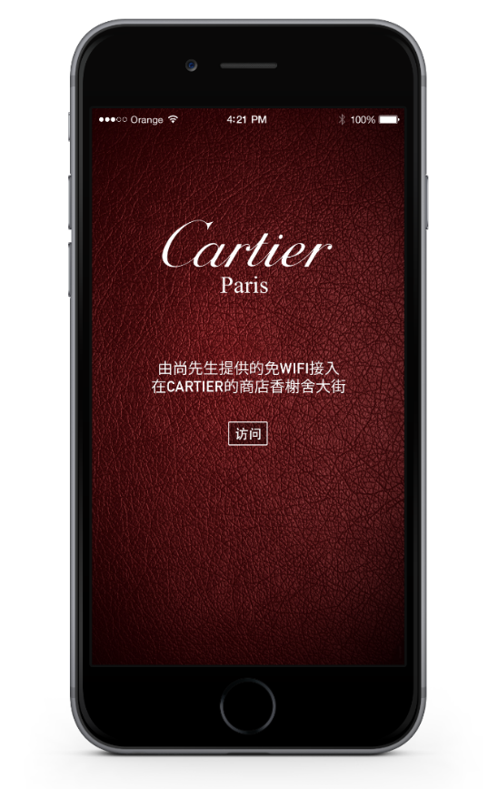
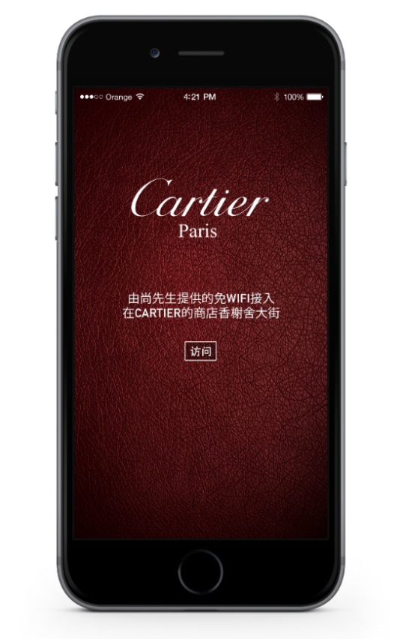
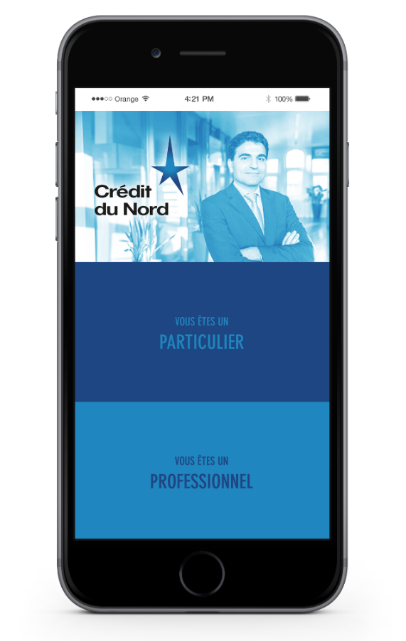


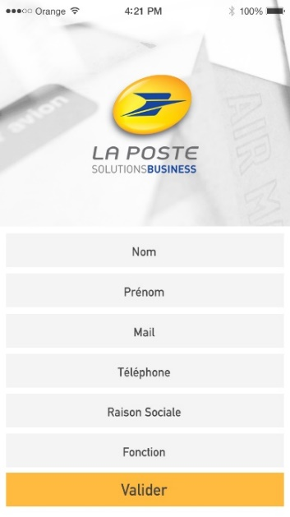
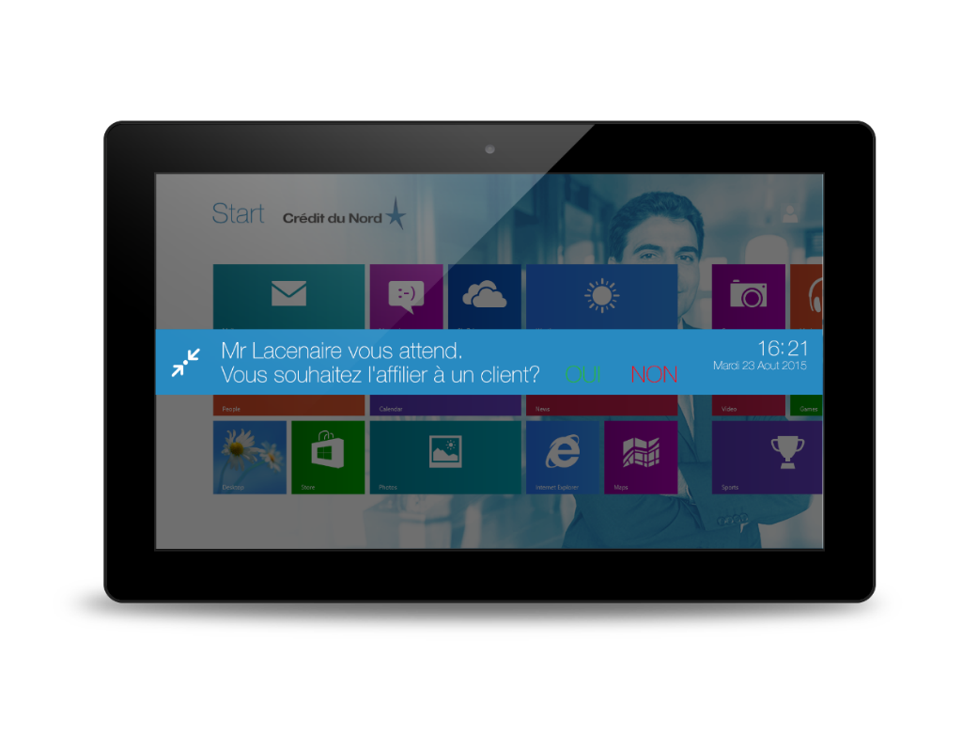
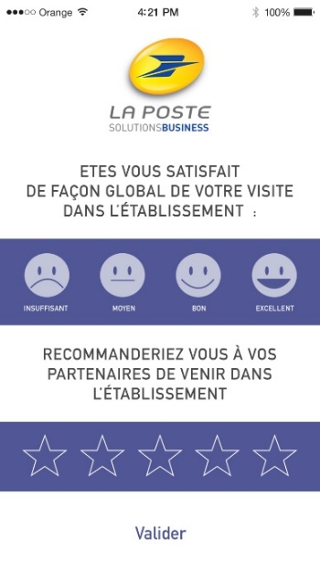

USE CASES
2.7
Captive Portal 2/2
A/B Testing
Digital Campaigns
Ipad Interaction

Slide 15
3.
DEVELOPMENT

Slide 16
PRODUCT ROADMAP
3.1
V1 Cloud Platform
Guest Wifi features
Dashboard
Splash Configuration
Users profiles
V3 Cloud Platform
Beacons Management
Wifi Analytics
S1 2018
S1 2019
V2 Cloud Platform
Splash Page Features
Connectors via APIs (Salesforce.com)
Marketing Automation
V4 Cloud Platform
Third parties data (cameras, POS…)
S2 2018
S2 2019

Slide 17

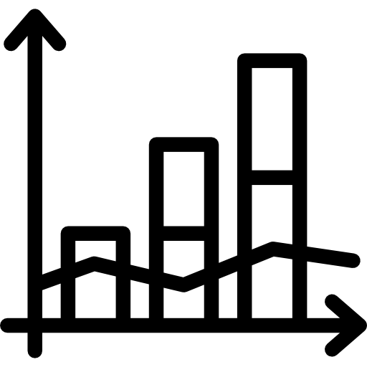





WHAT WE ACHIEVE SO FAR
3.2
Achieved bootstrapping phase
Product/market fit through top paying customers
€1 M in funding
€75 k revenues T1 2018
Built expert team (5 FTE)

Slide 18





HOW WE WILL GET TO 500k€ IN MRR IN 2020
3.3
Current customer base spans medium and large enterprises in priority with several potential contracts each
~ 15 contracts with annual license revenue of €200K
= €3 M
~ 3 contracts with annual license revenue of €135K
= €0,5 M
Large group with multi-sites
+
~ 100 contracts with annual license revenue of €25K
= €2,5 M
~ 15 contracts with annual license revenue of €15K
= €0,3 M
Medium-size retail, Hotel, Administration, airport…
+
~ 30 contracts with annual license revenue of €1K
= €0,1 M
Small-size retail, Hotel, car reseller…

Slide 19
FINANCIAL FORECASTS
3.4
Bootstrapped phase
Acceleration phase
1150
Revenues
€35,5 M
N°
Number of recurring contracts
550
170
€15,2 M
35
10
3
€4,2 M
€0,17 M
€0,3 M
€1 M

Slide 20
USE OF PROCEEDS
3.5
Scale Production
25%
Product Development
45%
55% in business development & operation structuration
€0,5 M
fundraising
Sales & Marketing
30%
Sales & Marketing
Scale Production
Product Development
Marketing campaigns
Brand image
Team hiring
Admin & support team
Legal
Material resources
UX development
Scalability improvement
Data
Cloud

Slide 21
DISCLAIMER
-
This report is confidential and has been prepared by Zodiac Finance.
The report has not been prepared with a view for public disclosure, whether under securities laws or otherwise, and, except with the prior written consent of Zodiac Finance, the report cannot be disclosed, copied or distributed to any third parties.
In preparing this report, Zodiac Finance has assumed and relied upon the accuracy and completeness of publicly disclosed information for the purpose of this report and has not assumed any responsibility for independent verification of such information. Such estimates, projections, targets or forecasts involve significant assumptions and subjective judgments which may or may not prove to be correct and there can be no assurance that any estimates, projections, targets or forecasts are attainable or will be realized. No representation or warranty, express or implied, is made by Zodiac Finance as to the accuracy, completeness or fairness of any information contained in this report and, so far as is permitted by law and except in the case of fraud by the party concerned, no responsibility or liability whatsoever is accepted for the accuracy or sufficiency thereof or for errors, omissions, or misstatements negligent or otherwise, relating thereto. In particular, but without limitation, no representation or warranty, express or implied, is given as to the achievement or reasonableness of, and no reliance may be placed for any purpose on the accuracy or completeness of, any estimates, projections, targets or forecasts and nothing in this report should be relied upon as a promise or representation as to the future.
The contents of this report are based upon conditions as they existed and could be evaluated as of the date hereof. By delivering this report, Zodiac Finance does not undertake any obligation to update any of the information of the analysis contained herein or to correct any inaccuracies which may become apparent.
If you have not received express written consent from Zodiac Finance to view this document, please return this document to the source from which you received it. This document must not be relied upon by any third party for the purposes of making an investment or any other decision.

Slide 22

CONTACT
-
Zodiac Finance
Norman Jost
17 rue du Colisée
75008 Paris
+33 6 03 87 64 54
norman.jost@zodiac-finance.com

